Slide 1


Retirement 101:
Retirement Financial Planning

Slide 2


About the Class
Donations of food go to Crisis Nursery Center
We used to teach this class at Mizzou
Lecture Portion: 50,000-foot POV down to a 5,000-foot POV
10-minute break at 2/3 point in the class
Case studies will bring it all together
Strictly academic class – NO specific products or services will be discussed
Cut to the chase – How to solve the problem
Bust some myths
Please put phones on silent
Take good notes - We’ll answer questions as time permits
Evaluation form – We hope St. Louis Community College adds to curriculum

Slide 3
Limitations of Liability and Disclaimer of Representations and Warranties
This presentation contains basic general information and is provided with the understanding that it is for educational purposes only and simply reflects our understanding of retirement issues in effect at the time of publication. Individual situations vary and the personal impact of various estate and retirement strategies should be carefully considered. Nothing discussed at this workshop shall be considered specific advice. This workshop is presented with the understanding that the company, its employees, representatives, partners, officers, agents or associates do not give legal or tax advice. The individual presenting does not practice law, and nothing in this workshop is ever to be viewed as legal counsel.
No specific investment advice is ever intended. Financial products and services can vary significantly. Therefore, some of the information provided in the workshop may not apply. Always examine the details of any financial product under consideration for its exact structure and provisions. Only a registered representative licensed with a registered broker/dealer may sell securities. Only qualified licensed individuals may sell insurance products. Only Registered Investment Advisors may charge fees. Any mention of interest rates or rates of return are purely hypothetical and not intended to represent any assurances or guarantees. Past performance is no guarantee of future results.
Financial & Tax Architects, Inc. is in no way affiliated with St. Louis Community College and St. Louis Community College does not endorse or support the content and/or its instructors provided for Retirement 101. St. Louis Community College assumes no responsibility or liability for any consequences resulting directly or indirectly for any action or inaction you take based on or made in reliance of the information, services or materials provided with Retirement 101. St. Louis Community College is not liable for any damage or loss related to the accuracy, completeness or timeliness of any information provided in Retirement 101.

Slide 4
Notes
____________________________________________________________
____________________________________________________________
____________________________________________________________
____________________________________________________________
____________________________________________________________
____________________________________________________________

Slide 5

Today’s Financial Environment:
You MUST Know What to Do When Something Goes Wrong
© 2022 FTA, Inc. All rights reserved

Slide 6
Notes
____________________________________________________________
____________________________________________________________
____________________________________________________________
____________________________________________________________
____________________________________________________________
____________________________________________________________

Slide 7
Fixing Problems in Retirement
(Filling The Gaps in Retirement)
Gaps = “Income Problems”
90% of the time
Problem-solving income shortages from a variety of causes.
Identify and eliminate the potential pitfalls in BOTH the:
    Distribution Phase of Retirement
    Accumulation Phase of Retirement
© 2022 FTA, Inc. All rights reserved

Slide 8
Notes
____________________________________________________________
____________________________________________________________
____________________________________________________________
____________________________________________________________
____________________________________________________________
____________________________________________________________

Slide 9
WHAT ARE “GAPS” (PROBLEMS)?
If your living expenses are greater than your retirement income
If your living expenses “inflate” faster than your income
If your income circumstances change due to:
  Death
  Health issues
  Market conditions
  Family situation
  Etc.

Slide 10
Notes
____________________________________________________________
____________________________________________________________
____________________________________________________________
____________________________________________________________
____________________________________________________________
____________________________________________________________

Slide 11
How to ensure that you have the proper insurance BOTH PRE and POST MEDICARE ELIGIBILITY
You need to work with a quality insurance broker
An insurance agent usually represents one company
An insurance broker usually represents multiple companies
Work with a broker who specializes in health insurance
An insurance broker is NOT a fiduciary
© 2022 FTA, Inc. All rights reserved

Slide 12
Notes
____________________________________________________________
____________________________________________________________
____________________________________________________________
____________________________________________________________
____________________________________________________________
____________________________________________________________

Slide 13
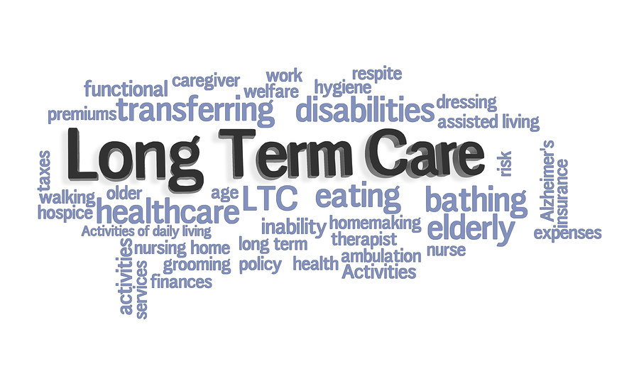
© 2022 FTA, Inc. All rights reserved

Slide 14
Notes
____________________________________________________________
____________________________________________________________
____________________________________________________________
____________________________________________________________
____________________________________________________________
____________________________________________________________

Slide 15
Long-Term Care
The Cost of Long-Term Care
National (median) Cost of Long-Term Care
Type of care | Cost per year
Nursing home¹ | $90,155 to $102,200
Assisted living facility¹ | $48,612
Home health aide services¹ | $52,624
¹ Genworth 2019 Cost of Care Survey, . For nursing home costs, $102,200 assumes a private room and $90,155 assumes a semi-private room. Assisted living facility costs assume a one-bedroom, single occupancy rate. Home health care costs assume home health care aide services 44 hours per week for 52 weeks.

Slide 16
Notes
____________________________________________________________
____________________________________________________________
____________________________________________________________
____________________________________________________________
____________________________________________________________
____________________________________________________________

Slide 17

Long-Term Care
Page 7-8
WILL YOU NEED IT?
The statistics vary but they all indicate that you are likely to need long-term care:
    Just under 70% of those Americans who live to the age of retirement will need long-term care services at some point in their lives¹
    The lifetime probability of becoming disabled in at least two activities of daily living or of being cognitively impaired is 68% for people age 65 and older²
¹ 2018 Long-Term Care Planning Handbook, reference Federal Handbooks, Inc.
² Reference AARP. Beyond 50. 2003: A Report to the Nation on Independent Living and Disability, 2003, (January 11, 2005).

Slide 18
Notes
____________________________________________________________
____________________________________________________________
____________________________________________________________
____________________________________________________________
____________________________________________________________
____________________________________________________________

Slide 19



Planning for Long Term Care Costs
Self Insure | Traditional Long Term Care Policy | Combination Policies
Notes:
Self Insure
Traditional Long Term Care Policy
Combination Policies
Annuities with Long Term Care Features
Life/LTC combo plans that qualifies under IRC 7702 and 101c

Slide 20
Notes
____________________________________________________________
____________________________________________________________
____________________________________________________________
____________________________________________________________
____________________________________________________________
____________________________________________________________

Slide 21
Planning for Long Term Care Costs
Self Insure | Traditional Long Term Care Policy | Combination Policies
  Annuities with Long Term Care Features
  Life/LTC combo plans that qualifies under IRC 7702 and 101c
Notes:
Self Insure
Traditional Long Term Care Policy
Combination Policies
Annuities with Long Term Care Features
Life/LTC combo plans that qualifies under IRC 7702 and 101c

Slide 22
Notes
____________________________________________________________
____________________________________________________________
____________________________________________________________
____________________________________________________________
____________________________________________________________
____________________________________________________________

Slide 23

What Happens After You’re Gone?

Slide 24
Notes
____________________________________________________________
____________________________________________________________
____________________________________________________________
____________________________________________________________
____________________________________________________________
____________________________________________________________

Slide 25

Asset Transfer at Death
Are Your Beneficiary Documents In Line?

Slide 26
Notes
____________________________________________________________
____________________________________________________________
____________________________________________________________
____________________________________________________________
____________________________________________________________
____________________________________________________________

Slide 27

DO YOU KNOW WHO YOUR BENEFICIARIES ARE?
Audit your beneficiaries
In the last 10 years, have you had any life changes that altered your beneficiaries?
Has your financial advisor offered to review your beneficiary designations?
Supreme Court ruled 9-0 in the Kennedy Case.
Do you have any old annuities, employee retirement accounts, bank accounts, or life insurance policies that you may have neglected to update?

Slide 28
Notes
____________________________________________________________
____________________________________________________________
____________________________________________________________
____________________________________________________________
____________________________________________________________
____________________________________________________________

Slide 29

We have covered what happens when you get sick and when you die….
What happens when you live longer than expected?

Slide 30
Notes
____________________________________________________________
____________________________________________________________
____________________________________________________________
____________________________________________________________
____________________________________________________________
____________________________________________________________

Slide 31
Life Expectancy - 2000
50% Chance of Living to
25% Chance of Living to
50% Chance of Living to
25% Chance of Living to
At Least One Person has a 50% Chance of Living to
At Least One Person has a 25% Chance of Living to
Source: Annuity 2000 Mortality Table, Society of Actuaries. Figures assume you are in good health.

Slide 32
Notes
____________________________________________________________
____________________________________________________________
____________________________________________________________
____________________________________________________________
____________________________________________________________
____________________________________________________________

Slide 33
Life Expectancy - 2020
50% Chance of Living to
25% Chance of Living to
50% Chance of Living to
25% Chance of Living to
At Least One Person has a 50% Chance of Living to
At Least One Person has a 25% Chance of Living to
Source: https://www.longevityillustrator.org/. (04/2021) Figures assume you are in good health.

Slide 34
Notes
____________________________________________________________
____________________________________________________________
____________________________________________________________
____________________________________________________________
____________________________________________________________
____________________________________________________________

Slide 35
Are Pensions in Trouble?
State pensions: Only 1 out of 50 States are fully funded*
Standard & Poor’s 500 Companies: 323 have pensions...Only 46 are fully funded**
All of the above numbers are based on the 2000 mortality tables.
Do you think the 2012 tables make these numbers better or worse?
*Center for Retirement Research, New York Times, & USA Today
**https://www.spglobal.com/spdji/en/documents/research/research-sp-500-corporate-pensions-and-OPEB-in-2018.pdf

Slide 36
Notes
____________________________________________________________
____________________________________________________________
____________________________________________________________
____________________________________________________________
____________________________________________________________
____________________________________________________________

Slide 37
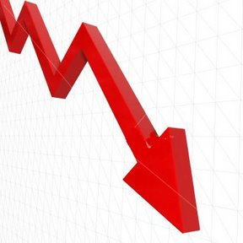
Financial Concerns
Running out of money
The stress and sleepless nights of watching your portfolio dwindle down.
Serious health event
Taxes
Inflation

Slide 38
Notes
____________________________________________________________
____________________________________________________________
____________________________________________________________
____________________________________________________________
____________________________________________________________
____________________________________________________________

Slide 39


Slide 40
Notes
____________________________________________________________
____________________________________________________________
____________________________________________________________
____________________________________________________________
____________________________________________________________
____________________________________________________________

Slide 41

Tax Analysis
Early 4th Quarter Mock Tax Return

Slide 42
Notes
____________________________________________________________
____________________________________________________________
____________________________________________________________
____________________________________________________________
____________________________________________________________
____________________________________________________________

Slide 43
Currently Taxable Investments
2022 Taxable Income | Interest & Ordinary Income | Qualified Dividends¹ & Long-Term Capital Gains
Joint Return
$0 - $20,550 | 10% | 0%
$20,551 - $83,550 | 12%
$83,051 - $178,150 | 22% | 15%
$178,151 – $340,100 | 24%
$340,101 - $431,900 | 32%
$431,901 - $647,850 | 35% | >$517,200 20%
$647,851+ | 37%
¹ Qualified dividends are from domestic corporations and certain foreign corporations but don’t include dividends from certain preferred stock and most REITs. The current maximum tax rate on long-term capital gains (excluding unrecaptured Section 1250 gain and gain from sales of collectables and qualifying small business stock) is 20%. Non-qualified dividends and short-term capital gains (for assets held less than 12 months) are taxed as ordinary income.
Consult your tax advisor pertaining to your specific situation.
© 2022 FTA, Inc. All rights reserved

Slide 44
Notes
____________________________________________________________
____________________________________________________________
____________________________________________________________
____________________________________________________________
____________________________________________________________
____________________________________________________________

Slide 45

Moving Money to the Right
Tax Diversification
Taxable
Tax
Deferred
Tax
Free
Solving problems now, by going down the right path early.
© 2022 FTA, Inc. All rights reserved

Slide 46
Notes
____________________________________________________________
____________________________________________________________
____________________________________________________________
____________________________________________________________
____________________________________________________________
____________________________________________________________

Slide 47
ONE QUICK CASE STUDY - 3 DIFFERENT CONCLUSIONS:
Tax Efficiency and Withdrawal Order
The order in which you take money out of your accounts can make a difference.
Age at beginning | 72
Taxable account value at beginning | $200,000
Traditional IRA account value at beginning | $500,000
Average annualized rate of return¹ | 5%
Income tax bracket² | 25%
Annual withdrawal³ | $25,000
¹ Compounded annually at end of period. Does not represent any specific investment.
² All taxable earnings are assumed to be taxed as interest income.
³ Withdrawn annually at end of period.
© 2022 FTA, Inc. All rights reserved

Slide 48
Notes
____________________________________________________________
____________________________________________________________
____________________________________________________________
____________________________________________________________
____________________________________________________________
____________________________________________________________

Slide 49
TAX EFFICIENCY AND WITHDRAWAL ORDER
He needs $25,000/year of income from his investments.
What’s the best way to get it?
Withdrawal choices:
Take all withdrawals from traditional IRAs and leave the taxable accounts alone
OR
Take the money from taxable accounts and only the required minimum distributions from traditional IRAs
Assumptions: Income taxes on Traditional IRA assets, including required minimum distributions, are taxed as withdrawn. They are paid by increasing the amount withdrawn from the IRA account by an amount equal to the taxes owed. Income taxes on the taxable account are assumed to be paid each year, and the annualized return was reduced to account for taxes paid.
© 2022 FTA, Inc. All rights reserved

Slide 50
Notes
____________________________________________________________
____________________________________________________________
____________________________________________________________
____________________________________________________________
____________________________________________________________
____________________________________________________________

Slide 51
WITHDRAWAL CHOICES — 25 YEARS LATER
Withdrawal from IRA’s Withdrawal from Taxable
n IRA Account n Taxable Account
IRA value | $53,091 |  | IRA value | $181,492
Taxable account value | $520,860 |  | Taxable account value | $433,988
Total value | $573,951 |  | Total value | $615,481
Assumptions: Average annualized rate of return is compounded annually at end of period. Hypothetical illustration, does not represent any specific investment. All taxable earnings are taxed as interest income. Annual withdrawals are taken at end of each period.
© 2022 FTA, Inc. All rights reserved

Slide 52
Notes
____________________________________________________________
____________________________________________________________
____________________________________________________________
____________________________________________________________
____________________________________________________________
____________________________________________________________

Slide 53

Inflation
© 2022 FTA, Inc. All rights reserved

Slide 54
Notes
____________________________________________________________
____________________________________________________________
____________________________________________________________
____________________________________________________________
____________________________________________________________
____________________________________________________________

Slide 55
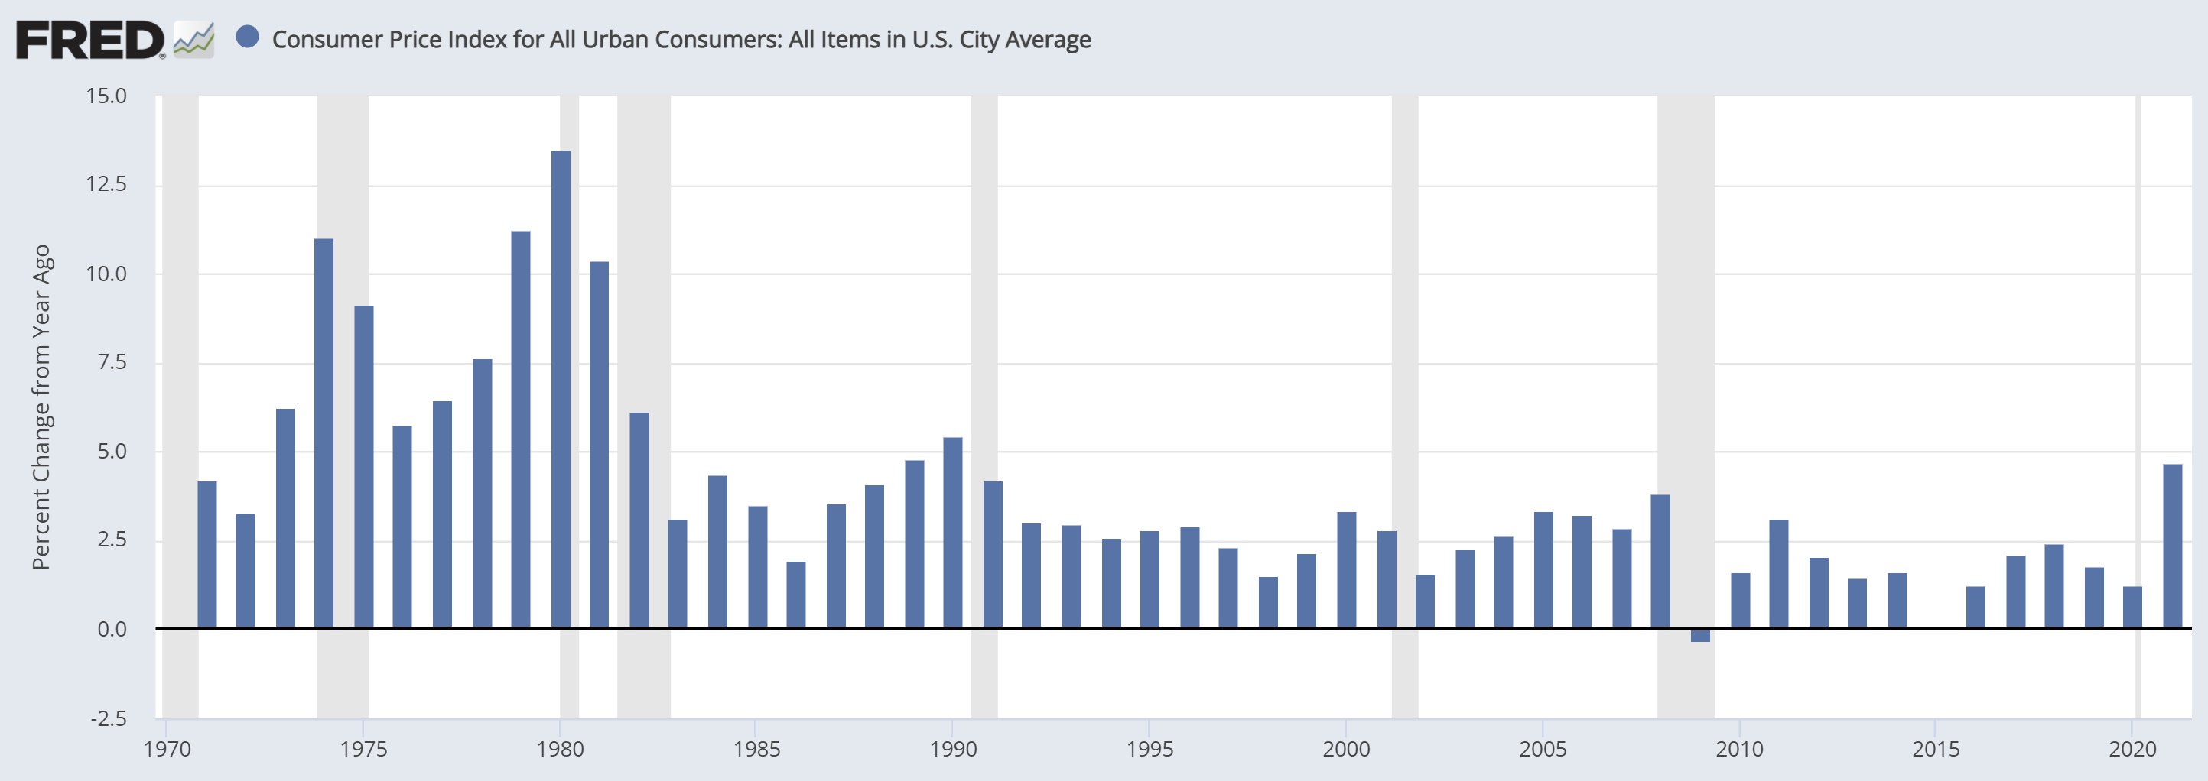
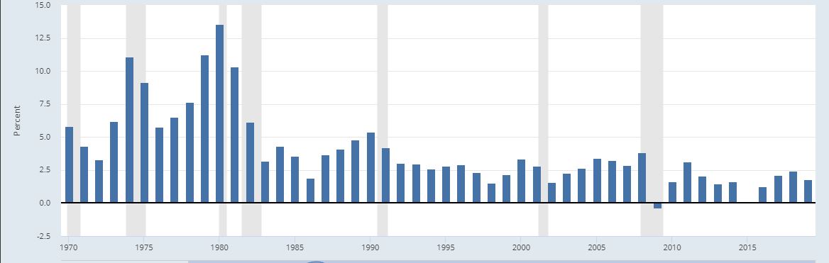
Historical Rates of Inflation
Source: Federal Reserve Bank of St. Louis (FRED) https://fred.stlouisfed.org/graph/?g=M7PJ
© 2022 FTA, Inc. All rights reserved

Slide 56
Notes
____________________________________________________________
____________________________________________________________
____________________________________________________________
____________________________________________________________
____________________________________________________________
____________________________________________________________

Slide 57
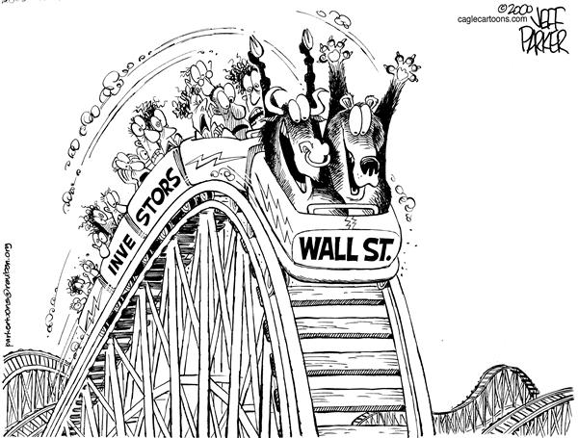
Market Volatility
© 2022 FTA, Inc. All rights reserved

Slide 58
Notes
____________________________________________________________
____________________________________________________________
____________________________________________________________
____________________________________________________________
____________________________________________________________
____________________________________________________________

Slide 59
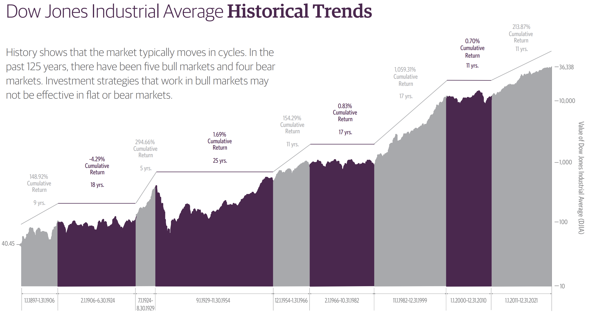
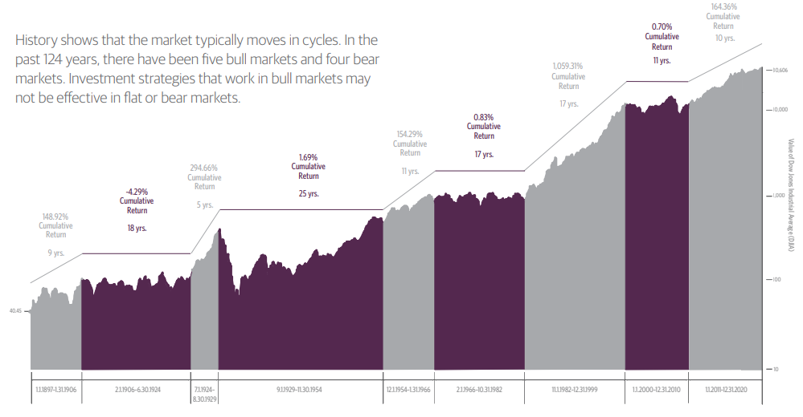
Dow Jones Historical Trends
https://www.guggenheiminvestments.com/dowjoneshistoricaltrends
© 2022 FTA, Inc. All rights reserved

Slide 60
Notes
____________________________________________________________
____________________________________________________________
____________________________________________________________
____________________________________________________________
____________________________________________________________
____________________________________________________________

Slide 61
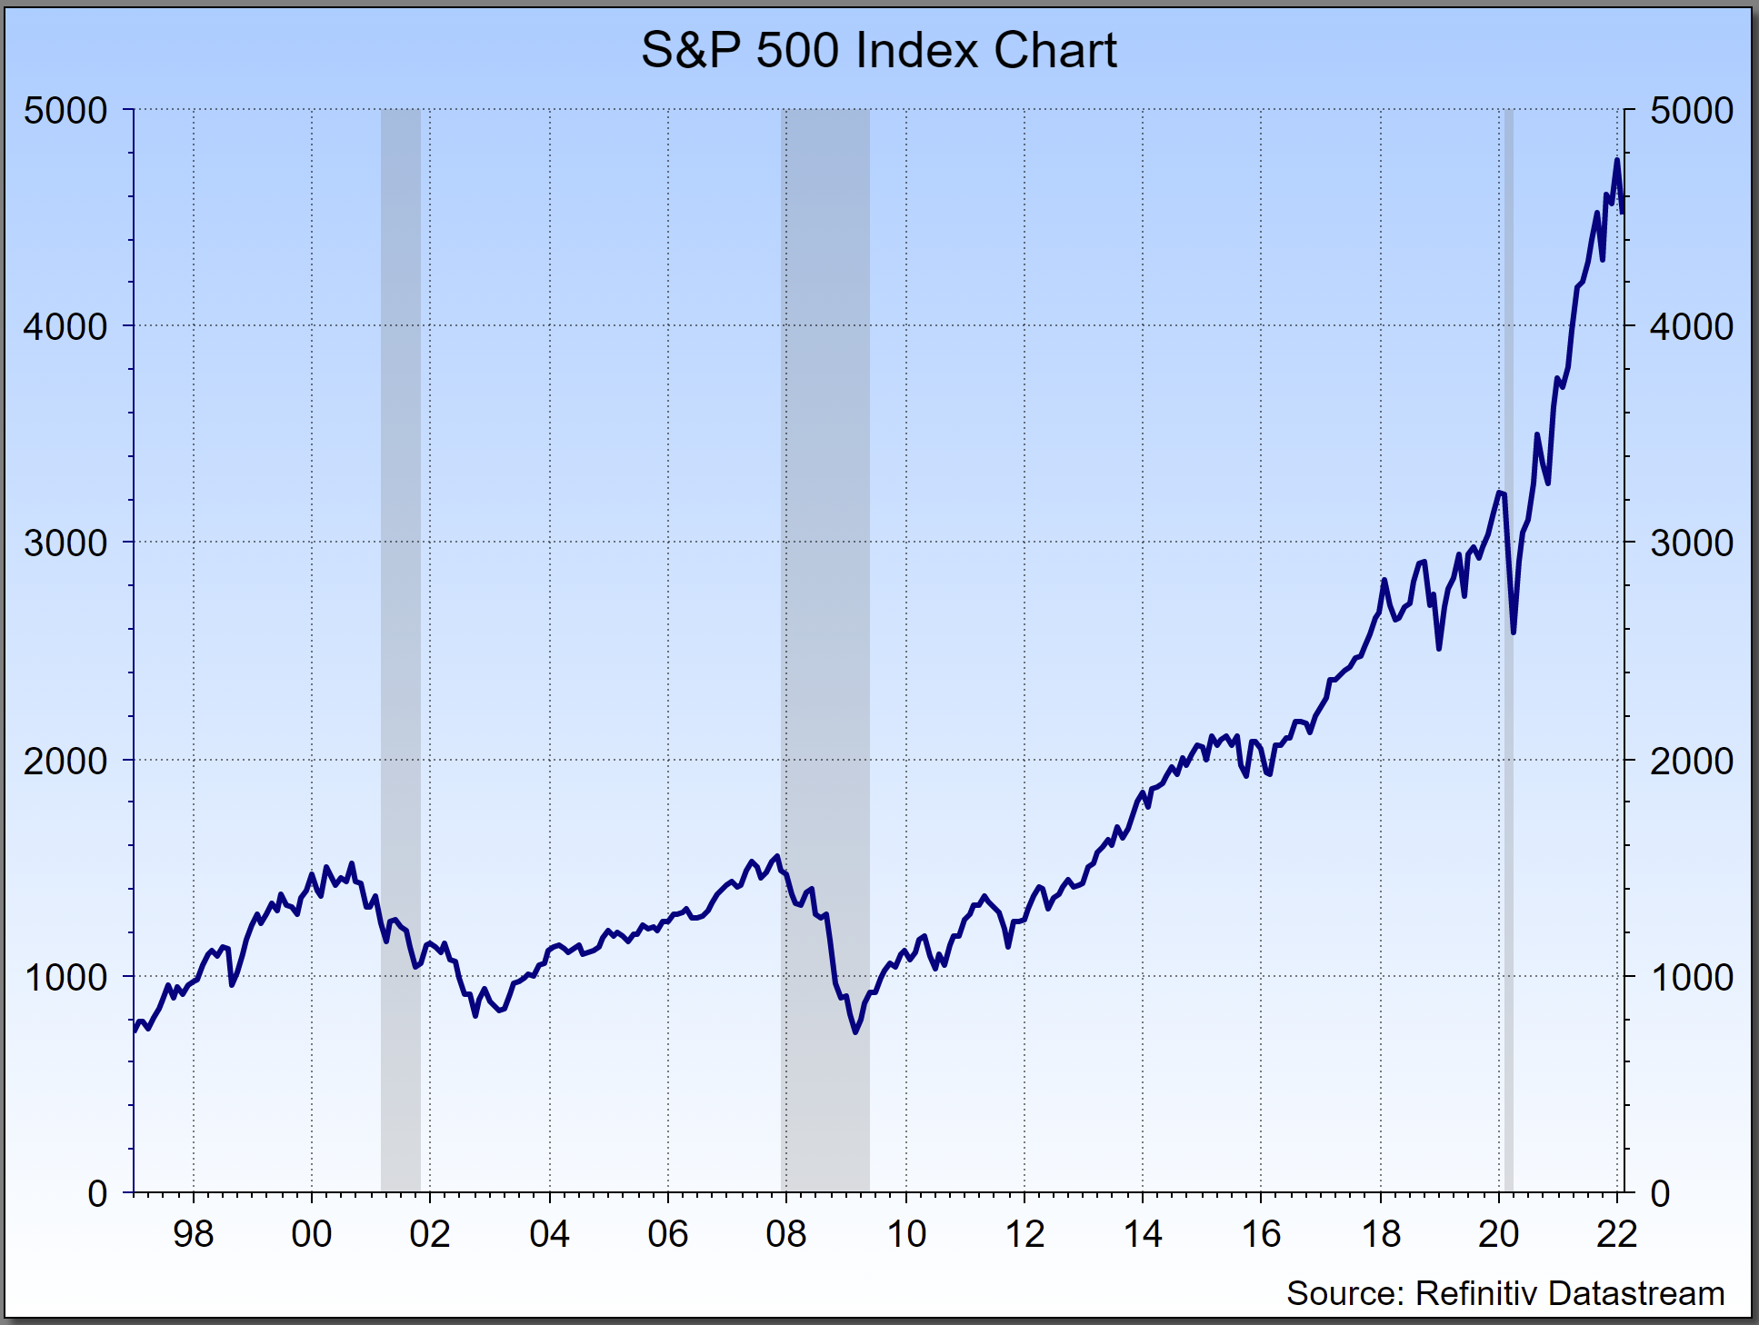
S&P 500 Index Chart
© 2022 FTA, Inc. All rights reserved

Slide 62
Notes
____________________________________________________________
____________________________________________________________
____________________________________________________________
____________________________________________________________
____________________________________________________________
____________________________________________________________

Slide 63
Volatility of the S&P 500
“The Lost Decade”…and Beyond
March 24, 2000: 1527
October 9, 2002: 778
October 9, 2007: 1565
March 9, 2009: 667
February 17, 2022: 4,422
-49%
+101%
7.1 %
Annualized (Total Return)
190%
-57%
+563%
* S&P 500 Total Return Index data. Source: Refinitiv
© 2022 FTA, Inc. All rights reserved

Slide 64
Notes
____________________________________________________________
____________________________________________________________
____________________________________________________________
____________________________________________________________
____________________________________________________________
____________________________________________________________

Slide 65
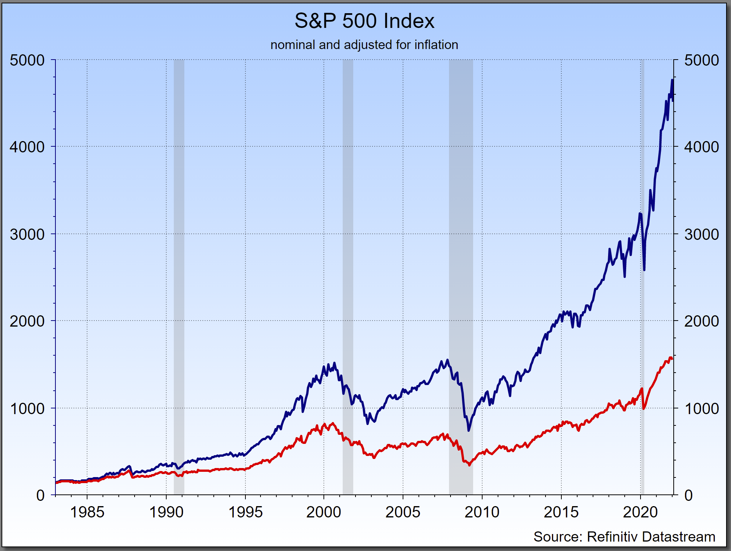
“The Lost Decade”…and Beyond
Is the S&P 500 at record highs?
Yes, In nominal terms
The S&P 500 is reported in nominal terms let’s examine in inflation adjusted terms
Down Until May 2015
Growth based planning just does not work...
© 2022 FTA, Inc. All rights reserved

Slide 66
Notes
____________________________________________________________
____________________________________________________________
____________________________________________________________
____________________________________________________________
____________________________________________________________
____________________________________________________________

Slide 67
STOCK MARKET GAINS AND LOSSES
Losses Hurt You More Than Gains Help You TM
© 2022 FTA, Inc. All rights reserved

Slide 68
Notes
____________________________________________________________
____________________________________________________________
____________________________________________________________
____________________________________________________________
____________________________________________________________
____________________________________________________________

Slide 69
Gains and Losses Are Not Equal
$100,000
$110,000
-10% ($11,000)
+10% ($10,000)
$110,000
$99,000
© 2022 FTA, Inc. All rights reserved

Slide 70
Notes
____________________________________________________________
____________________________________________________________
____________________________________________________________
____________________________________________________________
____________________________________________________________
____________________________________________________________

Slide 71
Gains and Losses Are Not Equal
100% Gain
10% Loss?
11% Gain
15% Loss?
18% Gain
20% Loss?
25% Gain
50% Loss?
© 2022 FTA, Inc. All rights reserved

Slide 72
Notes
____________________________________________________________
____________________________________________________________
____________________________________________________________
____________________________________________________________
____________________________________________________________
____________________________________________________________

Slide 73

Question:
Are All Advisors Created Equal???

Slide 74
Notes
____________________________________________________________
____________________________________________________________
____________________________________________________________
____________________________________________________________
____________________________________________________________
____________________________________________________________

Slide 75
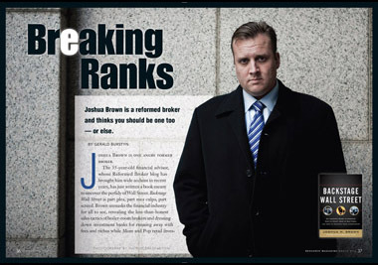
© 2022 FTA, Inc. All rights reserved

Slide 76
Notes
____________________________________________________________
____________________________________________________________
____________________________________________________________
____________________________________________________________
____________________________________________________________
____________________________________________________________

Slide 77
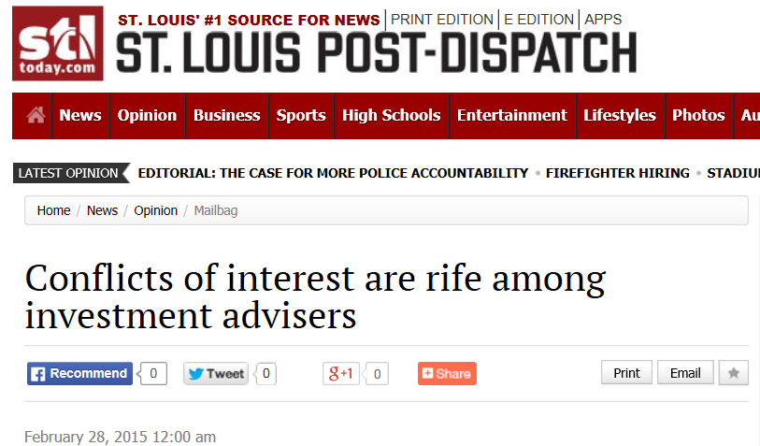
Conflicts of Interest
© 2022 FTA, Inc. All rights reserved

Slide 78
Notes
____________________________________________________________
____________________________________________________________
____________________________________________________________
____________________________________________________________
____________________________________________________________
____________________________________________________________

Slide 79
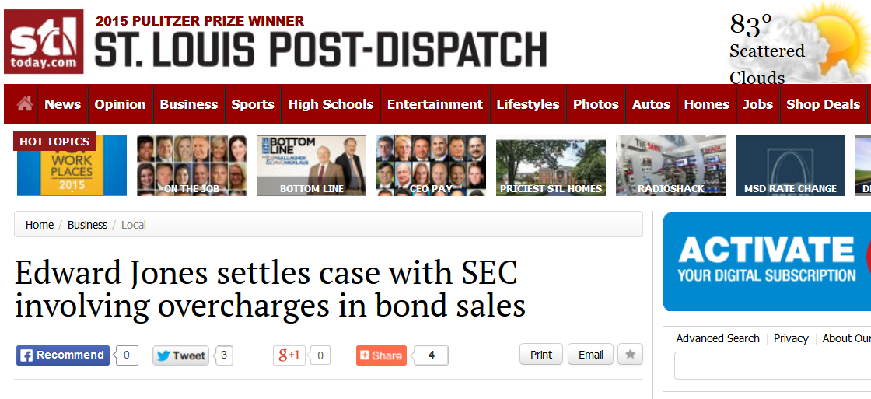
Conflicts of Interest
© 2022 FTA, Inc. All rights reserved

Slide 80
Notes
____________________________________________________________
____________________________________________________________
____________________________________________________________
____________________________________________________________
____________________________________________________________
____________________________________________________________

Slide 81

Conflicts of Interest
© 2022 FTA, Inc. All rights reserved

Slide 82
Notes
____________________________________________________________
____________________________________________________________
____________________________________________________________
____________________________________________________________
____________________________________________________________
____________________________________________________________

Slide 83
Fee-Based Fiduciaries
Fiduciaries act on behalf of their clients:
They work for and represent their clients (I.e., they don’t have some company or a manager telling them to “sell something”).
They are transparent with all fees, costs and expenses.
They disclose any and all conflicts of interest
Do not push products.
They do NOT act like financial salesmen.
They take the time to understand a client’s unique financial position before making any recommendations.
They take the time to create an individualized and customized comprehensive Retirement Financial Plan that accomplishes your goals.
A fiduciary is GOAL-FOCUSED.

Slide 84
Notes
____________________________________________________________
____________________________________________________________
____________________________________________________________
____________________________________________________________
____________________________________________________________
____________________________________________________________

Slide 85


What’s Your Income Stream?
© 2022 FTA, Inc. All rights reserved

Slide 86
Notes
____________________________________________________________
____________________________________________________________
____________________________________________________________
____________________________________________________________
____________________________________________________________
____________________________________________________________

Slide 87
Yesterday’s Retirement -
Your Parents and Grandparents’ Generation
Pension From Employer
Social Security
Personal Savings
Your Retirement Income sources used to be*:
  1/3 from Social Security
  2/3 from Employer and Personal Savings
  Their generation knew that between their pensions and SS, they were going to have all of their “needs” and even some of their “wants” taken care of!
© 2022 FTA, Inc. All rights reserved
Source: Social Security Administration

Slide 88
Notes
____________________________________________________________
____________________________________________________________
____________________________________________________________
____________________________________________________________
____________________________________________________________
____________________________________________________________

Slide 89
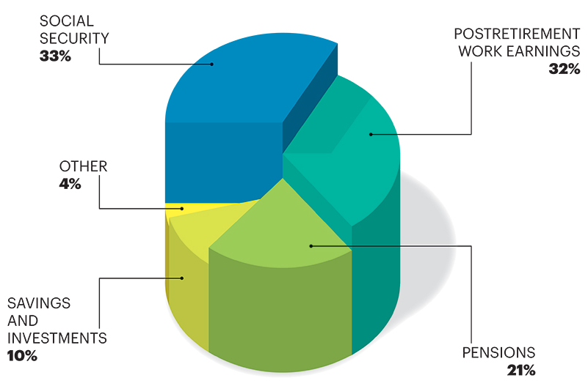
Today’s Retirement
Your Typical Retirement Income sources today:
1/3 from Government
2/3 from You
Retirement in OUR generation is
YOUR RESPONSIBILTY
Source: Social Security Administration, 2014

Slide 90
Notes
____________________________________________________________
____________________________________________________________
____________________________________________________________
____________________________________________________________
____________________________________________________________
____________________________________________________________

Slide 91

What If You Don’t Have a Pension?
What if you need more guaranteed income?
Can you create your own private pension?

Slide 92
Notes
____________________________________________________________
____________________________________________________________
____________________________________________________________
____________________________________________________________
____________________________________________________________
____________________________________________________________

Slide 93

When and How to File for
Social Security
© 2021 FTA, Inc. All rights reserved

Slide 94
Notes
____________________________________________________________
____________________________________________________________
____________________________________________________________
____________________________________________________________
____________________________________________________________
____________________________________________________________

Slide 95
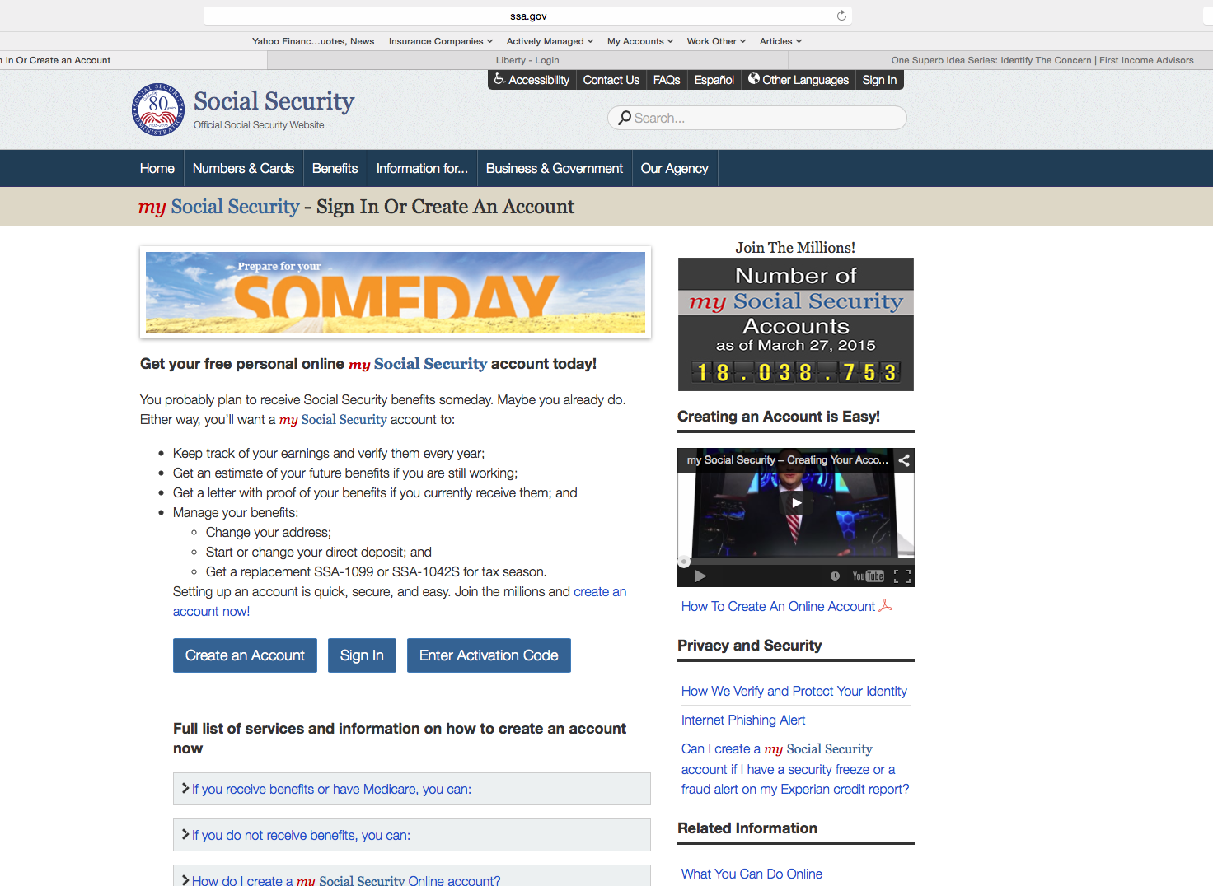
© 2022 FTA, Inc. All rights reserved

Slide 96
Notes
____________________________________________________________
____________________________________________________________
____________________________________________________________
____________________________________________________________
____________________________________________________________
____________________________________________________________

Slide 97
Lots of Options: There are often more than 10,000 different ways to take Social Security
Earliest Benefit: 62
Full Retirement Age: 661/2
(Primary Insurance Amount)
Delayed Benefit: 70
25% Less Income
DRC + 8% Year
You must do both a
SS Maximization Calculation
and a
Time Value of Money Calculation
© 2022 FTA, Inc. All rights reserved

Slide 98
Notes
____________________________________________________________
____________________________________________________________
____________________________________________________________
____________________________________________________________
____________________________________________________________
____________________________________________________________

Slide 99
What’s Your Income Stream?
© 2022 FTA, Inc. All rights reserved

Slide 100
Notes
____________________________________________________________
____________________________________________________________
____________________________________________________________
____________________________________________________________
____________________________________________________________
____________________________________________________________

Slide 101
© 2022 FTA, Inc. All rights reserved

Slide 102
Notes
____________________________________________________________
____________________________________________________________
____________________________________________________________
____________________________________________________________
____________________________________________________________
____________________________________________________________

Slide 103
Why are so many retirees afraid of running out of money?
Failing to put together a retirement income plan?
Lack of knowledge as to what’s available
Finding someone they trust
who will do it for them
Do not understand which tools accomplish which goals
Procrastination
Accumulation
vs.
Distribution
Overwhelmed by choices
© 2022 FTA, Inc. All rights reserved

Slide 104
Notes
____________________________________________________________
____________________________________________________________
____________________________________________________________
____________________________________________________________
____________________________________________________________
____________________________________________________________

Slide 105
You must understand that money behaves differently in the distribution phase than it does in the accumulation phase!
Therefore, as we’ve learned, your focus must be on:
  Risk
    Eliminate all unnecessary risk from your portfolio
    Mitigate the remaining risk in your portfolio
  The 4-Cornerstones of a Retirement Financial Plan are:
    Income
    Income
    Income
    Income
    If you have all the income you need to live and have a life, you do not have to worry about what the markets, the economy or inflation are doing. You are set for life!
© 2022 FTA, Inc. All rights reserved

Slide 106
Notes
____________________________________________________________
____________________________________________________________
____________________________________________________________
____________________________________________________________
____________________________________________________________
____________________________________________________________

Slide 107
Retirement Financial Planning
Distribution phase of your asset life cycle
What you have to do . . .
  Create a Private Pension from a portion of your assets and get guaranteed income for your life and your spouse’s life to fill GAPS
  Design an income stream that:
  Increases each year with the CPI (consumer price index).
  Provides a 100% survivor benefit for you and your spouse,
while giving you access to principle (just in case), and
  Allows you to pass the principle onto your heirs.
© 2022 FTA, Inc. All rights reserved

Slide 108
Notes
____________________________________________________________
____________________________________________________________
____________________________________________________________
____________________________________________________________
____________________________________________________________
____________________________________________________________

Slide 109

Income Planning: How much can you take each year?
5% Rule
4% Rule
3% Rule
Sequence Risk
© 2022 FTA, Inc. All rights reserved

Slide 110
Notes
____________________________________________________________
____________________________________________________________
____________________________________________________________
____________________________________________________________
____________________________________________________________
____________________________________________________________

Slide 111
Myth: Retirement Income Planning is a static calculation
(it is a variable calculation)
Paul and Julie were only two Years from retirement when their advisor told them they had 98% of what they’d need to retire.
This amount was accounted for by the $500,000 he had invested in the market.
Their advisor says that they can withdraw 5% or $25,000 from investments every year.
I asked Paul and Julie…What happens if the market drops
between now and the next two years?
I asked Paul…What happens if the market drops after you retire?
Do you have a Plan “B”?
© 2022 FTA, Inc. All rights reserved

Slide 112
Notes
____________________________________________________________
____________________________________________________________
____________________________________________________________
____________________________________________________________
____________________________________________________________
____________________________________________________________

Slide 113

Paul and Julie, like most people, believed that if they took 5%/year from their savings, that they’d never outlive their money!
Is that True?
© 2022 FTA, Inc. All rights reserved

Slide 114
Notes
____________________________________________________________
____________________________________________________________
____________________________________________________________
____________________________________________________________
____________________________________________________________
____________________________________________________________

Slide 115
Research proves that a 5%, 4% or even a 3% withdrawal strategy for retirement income portfolios is a myth!
© 2022 FTA, Inc. All rights reserved

Slide 116
Notes
____________________________________________________________
____________________________________________________________
____________________________________________________________
____________________________________________________________
____________________________________________________________
____________________________________________________________

Slide 117

Dr. Moshe A. Milevsky, author of
“The 7 Most Important Equations for your Retirement” and
Professor of Mathematics and Statistics at the Schulich School of Business at York University in Toronto, writes:.
“Once in retirement, you are no longer accumulating without withdrawals. Money acts differently once you retire and take withdrawals from your accounts. Depending on market conditions..during…your retirement, the safe withdrawal rates touted by retirement planning practitioners
prove to be a “myth.” --Dr. Milevsky
© 2022 FTA, Inc. All rights reserved

Slide 118
Notes
____________________________________________________________
____________________________________________________________
____________________________________________________________
____________________________________________________________
____________________________________________________________
____________________________________________________________

Slide 119
Working $100,000 in Accumulation
It Does Not Matter…
© 2022 FTA, Inc. All rights reserved

Slide 120
Notes
____________________________________________________________
____________________________________________________________
____________________________________________________________
____________________________________________________________
____________________________________________________________
____________________________________________________________

Slide 121
Distribution Phase:
Gains or Losses First? Does it Matter?
Out of Money at age 82!
It matters significantly!
© 2022 FTA, Inc. All rights reserved

Slide 122
Notes
____________________________________________________________
____________________________________________________________
____________________________________________________________
____________________________________________________________
____________________________________________________________
____________________________________________________________

Slide 123
Concluding Thoughts on Retirement Income Myths
You can not predict if the market will be up or if it will be down in your retirement. Our advice to you is:
You MUST have a written Retirement Financial Plan in place TODAY!
You must have enough Private Pension income to cover your income needs in retirement, both now and in the future.
You must plan today for “gaps” that may manifest in the future.
Never be dependent on the market for your income.
Your Retirement Financial Plan must be built on the 4 cornerstones of: Income, Income, Income, and Income.
You must eliminate all unnecessary risk from your portfolio.
You must mitigate the remaining risk.

Slide 124
Notes
____________________________________________________________
____________________________________________________________
____________________________________________________________
____________________________________________________________
____________________________________________________________
____________________________________________________________

Slide 125
Whether it’s a 5%, 4% or 3% withdrawal rate, it only works when markets are up!
Retirees can NOT predict future market direction or its effect on their Income.
You will lose lifetime income on each dollar taken out in down markets.
5% Rule (65%)
4% Rule (45%)
3% Rule (29%)
Sequence Risk
The market only comes back for those who do not rely on it for income!
This is a problem you MUST solve for!
© 2022 FTA, Inc. All rights reserved

Slide 126
Notes
____________________________________________________________
____________________________________________________________
____________________________________________________________
____________________________________________________________
____________________________________________________________
____________________________________________________________

Slide 127
Case Studies
After 10 min bathroom break…
© 2022 FTA, Inc. All rights reserved

Slide 128
Notes
____________________________________________________________
____________________________________________________________
____________________________________________________________
____________________________________________________________
____________________________________________________________
____________________________________________________________

Slide 129

Case Study #1
Husband and Wife both age 65
Asset | Amount
Husband’s Pension | $ 70,000
Husband’s Social Security | $ 20,000
Wife’s Pension | $ 5,000
Wife’s Social Security | $ 15,000
Total Income | $110,000
Their fiduciary helped them get the income they needed today. Now let’s look at what happens if . . .
Husband passes
© 2022 FTA, Inc. All rights reserved

Slide 130
Notes
____________________________________________________________
____________________________________________________________
____________________________________________________________
____________________________________________________________
____________________________________________________________
____________________________________________________________

Slide 131
Case Study #1 (cont.)
Husband and Wife
Husband dies at age 75
Asset | Amount
Husband’s Pension | $ 35,000
Husband’s Social Security | $ 20,000
Wife’s Pension | $ 5,000
Subtotal | $60,000
Wife loses half of Husband’s pension income
Wife loses her Social Security - she takes husband’s, the higher of the two.
But did we just lose $50,000 a year? Is that the problem?
How much $ does the wife need if the husband passes?
© 2022 FTA, Inc. All rights reserved

Slide 132
Notes
____________________________________________________________
____________________________________________________________
____________________________________________________________
____________________________________________________________
____________________________________________________________
____________________________________________________________

Slide 133
Case Study #1 (cont.)
Husband and Wife
Asset | Amount
Husband’s Pension | $ 70,000
Husband’s Social Security | $ 20,000
Wife’s Pension | $ 5,000
Wife’s Social Security | $ 15,000
Wife’s Private Pension | $ 10,000
Total Income | $120,000
The couple has just over a $1 million nest egg. The wife has $200,000 in an IRA. She uses her IRA to purchases a private pension that produces $10,000 a year income for both of their lives. Wife takes the income from private pension and buys $400,000 life insurance policy on Husband.
*denotes income from annuity based on wife’s age 65 with use of a GIBR (Guaranteed Income Benefit Rider) from a A+ rated insurance company. Based on the full faith and credit of the issuing carrier and is not FDIC insured. **Life insurance premium is $8,000 based on standard rating for Male, age 65, with an A+ insurance company. Withholding $2,000 of the annuity income to fund tax obligation
© 2022 FTA, Inc. All rights reserved

Slide 134
Notes
____________________________________________________________
____________________________________________________________
____________________________________________________________
____________________________________________________________
____________________________________________________________
____________________________________________________________

Slide 135
Case Study #1 (cont.)
Wife’s solution to losing $50,000 a year
Asset | Amount
Husband’s Pension | $ 35,000
Husband’s Social Security | $ 20,000
Wife’s Pension | $ 5,000
Wife’s Private Pension* | $ 10,000
Subtotal | $70,000
Income from Life Proceeds ** | $ 24,000
Total Survivorship Income | $94,000
* Denotes income from annuity based on Sally's age 65 with use of a GIBR (Guaranteed Income Benefit Rider) from an A rated insurance company. Based upon the full faith and credit of the issuing carrier and is not FDIC insured.
** denotes income 6% withdrawal from hypothetical account.
© 2022 FTA, Inc. All rights reserved

Slide 136
Notes
____________________________________________________________
____________________________________________________________
____________________________________________________________
____________________________________________________________
____________________________________________________________
____________________________________________________________

Slide 137
Case Study #1 (cont.)
Husband and Wife (Husband deceased, Wife 65)
You must map out your retirement income for rest of your life . You do this….. .
so you can eliminate the worry of running out of money and the stress of watching your nest egg go down?
… it’s a simple process to complete if:
  know what to look for
  know the right questions to ask
Let us show you how to map out your retirement income . . .
© 2022 FTA, Inc. All rights reserved

Slide 138
Notes
____________________________________________________________
____________________________________________________________
____________________________________________________________
____________________________________________________________
____________________________________________________________
____________________________________________________________

Slide 139
The Solution
Map out you and your spouse’s lifetime retirement income
Then you play the “What if?” game:
What if HE dies first?
What if SHE dies first?
What if there is a long-term care crisis?
What if the market crashes?
What if there is higher than expected inflation?
You MUST plan for all of these scenarios to eliminate the nagging worry of financial security in retirement
© 2022 FTA, Inc. All rights reserved

Slide 140
Notes
____________________________________________________________
____________________________________________________________
____________________________________________________________
____________________________________________________________
____________________________________________________________
____________________________________________________________

Slide 141
Simple Process to Plan Retirement Income
We will provide you with our Data Form to assist you in assembling:
#1 - Your Social Security Benefit Statement Pages
#2 - Any pension you or your spouse are entitled to receive
#3 - Any 401K / IRA / 403B / TSP/ IRA/ Simple IRA/ SEP IRA statements
#4 - Any non-IRA account statements (ie Bank, Brokerage, Savings Bonds)
Lifetime
Income
Spreadsheet

Slide 142
Notes
____________________________________________________________
____________________________________________________________
____________________________________________________________
____________________________________________________________
____________________________________________________________
____________________________________________________________

Slide 143

You Gather, We Analyze.
Creating the Lifetime Income Spreadsheet
  Our former students say that they have never seen such a clear and easy to understand format
  This Lifetime Income Spreadsheet will answer the questions you have about:
  How to create guaranteed income for life.
  How to invest with the philosophy that “LOSSES HURT YOU, MORE THAN GAINS HELP YOUTM,” and strive to never experience unacceptable losses

Slide 144
Notes
____________________________________________________________
____________________________________________________________
____________________________________________________________
____________________________________________________________
____________________________________________________________
____________________________________________________________

Slide 145

Case Study #2
Husband and Wife, both age 66
Husband and Wife are “do-it-yourselfers,” who like to manage their own money
Both their parents had a Long Term Care crisis, and had to spend down huge sums of their estate.
They don’t want to put their children through the same situation
If they are “DIY’ers” why would they want to meet with a fiduciary?
Let’s take a look at their finances. . .
© 2022 FTA, Inc. All rights reserved

Slide 146
Notes
____________________________________________________________
____________________________________________________________
____________________________________________________________
____________________________________________________________
____________________________________________________________
____________________________________________________________

Slide 147
Case Study #2 (cont.)
Husband and Wife, both age 66
Asset | Amount
Income from Assets | $ 60,000
Husband’s Social Security | $ 28,000
Wife’s Social Security | $ 20,000
Total Income | $108,000
They have enough retirement income, but do not want to go through the spend down
They would also like to leave their IRA’s and other assets to their children, in a tax-efficient and cost-efficient manner.
© 2022 FTA, Inc. All rights reserved

Slide 148
Notes
____________________________________________________________
____________________________________________________________
____________________________________________________________
____________________________________________________________
____________________________________________________________
____________________________________________________________

Slide 149
Case Study #2 (cont.)
Husband and Wife, both age 66
Their fiduciary helped them set up the following:
Establish a $500,000 7702 Life/LTC Combo Plan* for each spouse.
* Policy provides LTC rider that qualifies under section 7702b of HIPAA.
© 2022 FTA, Inc. All rights reserved

Slide 150
Notes
____________________________________________________________
____________________________________________________________
____________________________________________________________
____________________________________________________________
____________________________________________________________
____________________________________________________________

Slide 151

Properly Passing IRA Money to Your Kids
Employing the 2019 Secure Act 10 Year Stretch IRA
The Secure Act STRETCH IRA
Properly naming your children as the beneficiary of an IRA may allow them to take distributions over 10 years or delay taking distributions for up to 10 years.
NOTE: We do not provide individual tax or legal advice.
Please consult your attorney or tax professional.
We are not tax attorneys nor are we giving tax advice. Please consult your tax professional.
© 2022 FTA, Inc. All rights reserved

Slide 152
Notes
____________________________________________________________
____________________________________________________________
____________________________________________________________
____________________________________________________________
____________________________________________________________
____________________________________________________________

Slide 153

Case Study #3
Husband age 69, Wife age 66
They worked for 40 years
Paid for college for their kids
Ready to retire, but.. They have contrasting philosophies about their money.
No Pension Plan, but they have paid all their debt
© 2022 FTA, Inc. All rights reserved

Slide 154
Notes
____________________________________________________________
____________________________________________________________
____________________________________________________________
____________________________________________________________
____________________________________________________________
____________________________________________________________

Slide 155
Case Study #3
Husband age 69, Wife age 66
Husband (Aggressive)
Wife (Conservative)
He has $375,000 in his IRA and figures he can manage account himself
He wants 4% per year ($15,000) withdrawals for life, wants to pick his assets
Social Security $24,000
Asset Income $15,000
Total Income $39,000
He loves to aggressively trade his portfolio, but his main priority is making sure his wife will be taken care of
She has $400,000 in her IRA and is extremely conservative.
She set up a Private Pension that pays her $20,000 a year for the rest of their lives.
Social Security $18,000
Asset Income $20,000
Total Income $38,000
If husband passes first, he wants to make sure wife is secure. Their fiduciary worked with them to decide that $60,000/year will cover the wife’s income needs if he is gone.
© 2022 FTA, Inc. All rights reserved

Slide 156
Notes
____________________________________________________________
____________________________________________________________
____________________________________________________________
____________________________________________________________
____________________________________________________________
____________________________________________________________

Slide 157
Case Study #3 (cont.)
Husband age 68, Wife age 65
Wife’s Survivorship Income
Husband’s Social Security | $ 24,000
Wife’s Private Pension | $ 20,000
Sub Total | $ 44,000
Inherited IRA Income* | $16,500
Total Survivorship Income | $60,500
*Wife inherits Husband’s IRA of $375,000 under “spousal continuance” and uses $300,000 of those assets to purchase a second Private Pension. She invests the remaining $75,000 with a diversified portfolio of low-risk Private Wealth Strategies.
* Denotes income from Private pension annuity based on wife's age 70 with use of a GIBR (Guaranteed Income Benefit Rider) from an A rated insurance company.
* Based upon the full faith and credit of the issuing carrier and is not FDIC insured
© 2022 FTA, Inc. All rights reserved

Slide 158
Notes
____________________________________________________________
____________________________________________________________
____________________________________________________________
____________________________________________________________
____________________________________________________________
____________________________________________________________

Slide 159

Case Study #4)
Husband and Wife both 59.5 and in Good Health
Account | Value
Allan 401k | $300,000
Allan Roth | $50,000
Alice IRA | $75,000
Alice Roth | $50,000
Joint Brokerage | $125,000
Joint Checking | $25,000
Total | $625,000
© 2022 FTA, Inc. All rights reserved

Slide 160
Notes
____________________________________________________________
____________________________________________________________
____________________________________________________________
____________________________________________________________
____________________________________________________________
____________________________________________________________

Slide 161
Case Study #4 (cont.)
Husband and Wife both 59.5 and in Good Health
Monthly Income
Account | Monthly | Transfer on Death
Allan Pension | $2,100 | 100% to Alice
Allan SS | $1,800 | 100% to Alice
Alice Pension | $600 | 100% to Allan
Alice SS | $1,200 | Lost when either dies
Total Household Income | $5,700
If either spouse passes | -$1,200 | Alice SS goes away
Surviving Spouse Income | $4,500
© 2022 FTA, Inc. All rights reserved

Slide 162
Notes
____________________________________________________________
____________________________________________________________
____________________________________________________________
____________________________________________________________
____________________________________________________________
____________________________________________________________

Slide 163
Case Study #4 (cont.)
Husband and Wife both 59.5 and in Good Health
Allan and Alice’s Concerns:
  They want an additional $10,000/year of after-tax guaranteed income for FUN!!!!
  They are concerned about protecting their estate from the “spend down” associated with a LTC crisis.
  They want to leave an inheritance to their children in a cost and tax-efficient manner.
  They don’t want to pay too much in taxes.
  They want to get good returns, but don’t want big losses.
© 2022 FTA, Inc. All rights reserved

Slide 164
Notes
____________________________________________________________
____________________________________________________________
____________________________________________________________
____________________________________________________________
____________________________________________________________
____________________________________________________________

Slide 165
Case Study #4 (cont.)
Husband and Wife both 59.5 and in Good Health
Solutions: What did their Fiduciary Recommend they do?
1. Do an “in-service rollover” on Allan’s $300,000 401k into an IRA.
Invest $240,000 of Allan’s $300,000 IRA into an IRA Private Pension which will pay a guaranteed income of $12,000/year to them for the rest of their lives starting in three years when they retire. This will net them out ~ $10,000 year of after-tax income that they will use for FUN!!!!
2. Move $100,000 of brokerage account into Life/LTC combo plan that qualifies under IRC 7702 and 101c with historical average returns of potentially ~ 5% - 7% on the $50k they deposited into each of their accounts. This gives each Allan and Alice ~$200,000 of Life/LTC coverage ($400,000 total of 7702 coverage).
© 2022 FTA, Inc. All rights reserved

Slide 166
Notes
____________________________________________________________
____________________________________________________________
____________________________________________________________
____________________________________________________________
____________________________________________________________
____________________________________________________________

Slide 167
Case Study #4 (cont.)
Husband and Wife both 59.5 and in Good Health
Solutions (cont.)
3. Move both Roth IRA’s, the remaining IRA’s and the remaining brokerage account assets into a properly allocated, diversified portfolio of Private Wealth Strategies, preferably with historical returns equal to or exceeding the market (preferably with average historical and back tested returns of their PWS portfolio over the last 20+ years that has been greater than their appropriate indexes) with annual year-over-calendar-year losses preferably not greater 5% - 10% when possible.
4. Leave the cash in bank alone.
5. Their fiduciary helped them prepare to meet with an attorney to set up a living trust with all appropriate accompanying documents.
6. Perform beneficiary audit to ensure that all beneficiaries are correct, and trust is properly funded.
7. Meet with fiduciary twice per year (or when a major life event occurs) to review plan and make any necessary changes.
© 2022 FTA, Inc. All rights reserved

Slide 168
Notes
____________________________________________________________
____________________________________________________________
____________________________________________________________
____________________________________________________________
____________________________________________________________
____________________________________________________________

Slide 169

Case Study #5
Husband and Wife both 62 and in Good Health
Bob is a “do-it-yourselfer”
They are smart and sophisticated individuals
Bob enjoys sitting in front of the computer and trading their stocks.
They have a living trust and meet with the attorney every two years. They have enough income coming to meet their needs, as long as they don’t have a major “spend down” in their Portfolio or they don’t experience a “fatal fluctuation” loss in the market, like happened in 2000-02 and 2008-09.
Their portfolio is $2,500,000
© 2022 FTA, Inc. All rights reserved

Slide 170
Notes
____________________________________________________________
____________________________________________________________
____________________________________________________________
____________________________________________________________
____________________________________________________________
____________________________________________________________

Slide 171
Case Study #5 (cont.)
Husband and Wife both 62 and in Good Health
Concerns
1. Betty is worried that if something happens to Bob, she won’t be able to take care of the portfolio. She is “kind of” ok with Bob doing it himself but would not be comfortable doing it herself if something happened to Bob.
2. They have both seen family members and friends go through a long-term care crisis where they had to “spend down” massive sums of their estate due to a LTC crisis, and the Bakers have no desire to see that repeated in their lives.
3. The Bakers realize they have enough money to live comfortably for the rest of their lives if they don’t have to go through the spend down and they don’t experience market losses like those that occurred in 2000-02 or 2008-09.
4. They want to leave their estate to their children.
5. Over $1,750,000 of their portfolio is in traditional IRA’s and they are worried about the taxes that their kids will pay on that inheritance.
© 2022 FTA, Inc. All rights reserved

Slide 172
Notes
____________________________________________________________
____________________________________________________________
____________________________________________________________
____________________________________________________________
____________________________________________________________
____________________________________________________________

Slide 173
Case Study #5 (cont.)
Husband and Wife both 62 and in Good Health
Solution: Here is what a fiduciary might recommend:
1. Bob and Betty each set up a $500,000 Life/LTC combo plan that qualifies under IRC 7702 and 101c. This protects them for the “spend down”.
2. Bob reluctantly allows a fiduciary that they feel comfortable with to manage $250,000 of his portfolio to ensure that the fiduciary can deliver on their promises and give Betty “peace of mind” to know that someone she can trust will be there to help manage her portfolio in the event that Bob predeceases her.
3. The fiduciary performs a beneficiary audit
4. The fiduciary reviews* their trust for any investment plan considerations.
*Fiduciary is not an attorney and does not provide legal advice.
© 2022 FTA, Inc. All rights reserved

Slide 174
Notes
____________________________________________________________
____________________________________________________________
____________________________________________________________
____________________________________________________________
____________________________________________________________
____________________________________________________________

Slide 175
Case Study #5 (cont.)
Husband and Wife both 62 and in Good Health
Solutions (cont.)
5. The fiduciary performs a risk analysis on Bob’s portfolio and makes recommendations to him on how to lower the risk on the portfolio that Bob is still self-managing to help decrease the odds of experiencing big losses like occurred in 2000-02 and 2008-09.
6. The fiduciary helps the Bakers set up all the documentation for Secure Act compliant 10 year stretch IRAs on their accounts and helps them set up with a custodian that will allow them to do the stretch IRA as per their wishes.
7. They meet with the fiduciary four times per year to review their holdings and have their questions answered.
© 2022 FTA, Inc. All rights reserved

Slide 176
Notes
____________________________________________________________
____________________________________________________________
____________________________________________________________
____________________________________________________________
____________________________________________________________
____________________________________________________________

Slide 177
How A Quality Fee-Based Fiduciary Builds A
“GOALS - based” Retirement Financial Plan
Creating Your Own Retirement Road Map
THEN:
ESTABLISH A WRITTEN RETIREMENT PLAN THAT INCLUDES:
Income Plan that provides guaranteed income for life, so you can accomplish all your RETIREMENT GOALS and ENSURE you never run out of money
Financial Plan and cover tax planning, estate planning, insurance planning, etc. and then review and maintain the plan on an ongoing basis
Investment Plan that takes the least amount of risk necessary to get the returns you want, so you can accomplish all your retirement goals and enjoy the rest of your life
Identify where you are at today
Identify your needs, goals, and desires
Identify your Risk Tolerance and Retirement Plan “GAPS”
© 2022 FTA, Inc. All rights reserved

Slide 178
Notes
____________________________________________________________
____________________________________________________________
____________________________________________________________
____________________________________________________________
____________________________________________________________
____________________________________________________________

Slide 179
Final Case Study: You
To finish this class, we’d like to offer each of you a chance to come into our office to put together
your Retirement Financial Plan.

Slide 180
Notes
____________________________________________________________
____________________________________________________________
____________________________________________________________
____________________________________________________________
____________________________________________________________
____________________________________________________________

Slide 181
Knowing Your Numbers
Knowing You’ve Planned Right
Peace of Mind
© 2022 FTA, Inc. All rights reserved

Slide 182
Notes
____________________________________________________________
____________________________________________________________
____________________________________________________________
____________________________________________________________
____________________________________________________________
____________________________________________________________

Slide 183

To Get the Right Outcome…
© 2022 FTA, Inc. All rights reserved

Slide 184
Notes
____________________________________________________________
____________________________________________________________
____________________________________________________________
____________________________________________________________
____________________________________________________________
____________________________________________________________

Slide 185

You need the right ingredients.
You need to know how to put them together properly.
You need to know what to do if something goes wrong.
You get ONE CHANCE to retire – you HAVE to do it right the first time!
© 2022 FTA, Inc. All rights reserved

Slide 186
Notes
____________________________________________________________
____________________________________________________________
____________________________________________________________
____________________________________________________________
____________________________________________________________
____________________________________________________________

Slide 187
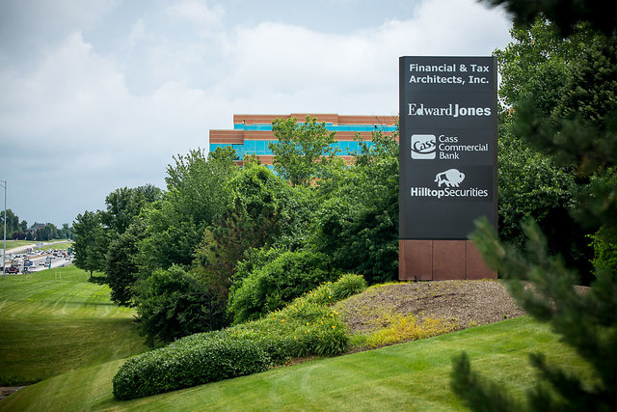
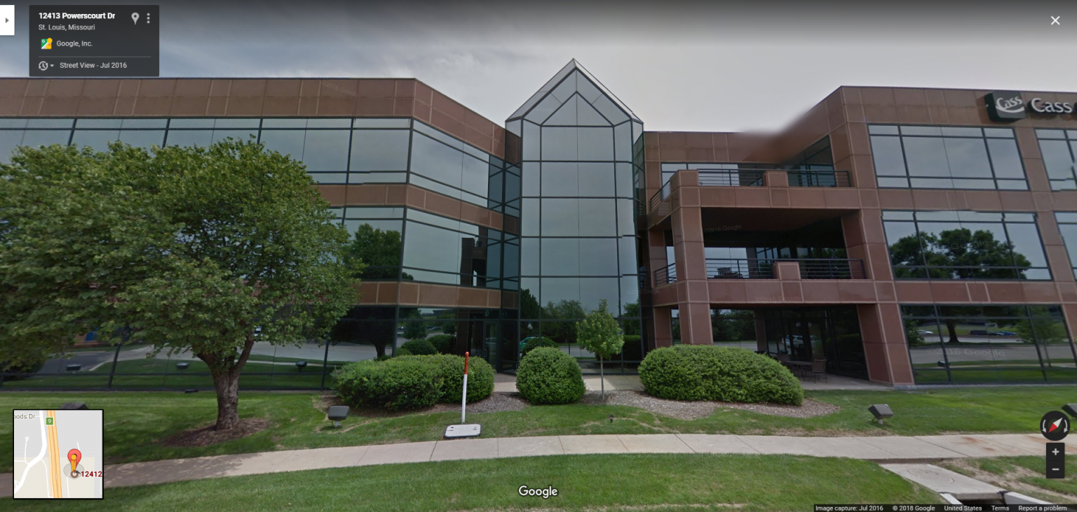
Financial & Tax Architects, Inc.
12412 Powerscourt Drive, Suite 25
Manchester and 270
Just North of West County Center
© 2022 FTA, Inc. All rights reserved

Slide 188

Please take a few minutes to complete BOTH sides of the evaluation form and turn them in to one of our staff members.
We will be available for a few minutes to answer general questions.
If you have specific questions, we will answer those when we meet privately to put together your personalized and customized Retirement Financial Plan.
© 2022 FTA, Inc. All rights reserved

